Slide 1

Digital Design
Chapter 3:
Sequential Logic Design -- Controllers
Slides to accompany the textbook Digital Design, First Edition,
by Frank Vahid, John Wiley and Sons Publishers, 2007.
http://www.ddvahid.com
Copyright © 2007 Frank Vahid
Instructors of courses requiring Vahid's Digital Design textbook (published by John Wiley and Sons) have permission to modify and use these slides for customary course-related activities, subject to keeping this copyright notice in place and unmodified. These slides may be posted as unanimated pdf versions on publicly-accessible course websites.. PowerPoint source (or pdf with animations) may not be posted to publicly-accessible websites, but may be posted for students on internal protected sites or distributed directly to students by other electronic means. Instructors may make printouts of the slides available to students for a reasonable photocopying charge, without incurring royalties. Any other use requires explicit permission. Instructors may obtain PowerPoint source or obtain special use permissions from Wiley – see http://www.ddvahid.com for information.

Slide 2
Introduction
3.1
Sequential circuit
  Output depends not just on present inputs (as in combinational circuit), but on past sequence of inputs
    Stores bits, also known as having “state”
  Simple example: a circuit that counts up in binary
In this chapter, we will:
  Design a new building block, a flip-flop, that stores one bit
  Combine that block to build multi-bit storage – a register
  Describe the sequential behavior using a finite state machine
  Convert a finite state machine to a controller – a sequential circuit having a register and combinational logic
1
a
1
0
Combinational
digital circuit
F
b
1
a
Sequential
digital circuit
?
0
F
b
si
ansis
Must know sequence of past inputs to know output
e
z
Note: Slides with animation are denoted with a small red "a" near the animated items

Slide 3
Example Needing Bit Storage
3.2
Call
button
Blue light
Flight attendant call button
  Press call: light turns on
    Stays on after button released
  Press cancel: light turns off
  Logic gate circuit to implement this?
Bit
Storage
Cancel
button
1. Call button pressed – light turns on
Call
button
Blue light
Bit
Storage
a
Cancel
button
Call
Q
2. Call button released – light stays on
Cancel
a
Doesn’t work. Q=1 when Call=1, but doesn’t stay 1 when Call returns to 0
Call
button
Blue light
Bit
Storage
Cancel
button
Need some form of “feedback” in the circuit
3. Cancel button pressed – light turns off

Slide 4
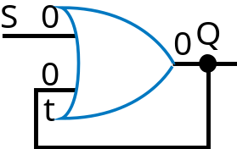

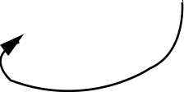
First attempt at Bit Storage
We need some sort of feedback
  Does circuit on the right do what we want?
    No: Once Q becomes 1 (when S=1), Q stays 1 forever – no value of S can bring Q back to 0
S
Q
t
S
1
S
1
Q
S
1
Q
S
0
Q
0
Q
1
1
1
a
0
0
1
1
t
t
t
t
S
1
0
t
1
0
Q
1
0

Slide 5

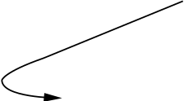
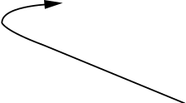
Bit Storage Using an SR Latch
Does the circuit to the right, with cross-coupled NOR gates, do what we want?
  Yes! How did someone come up with that circuit? Maybe just trial and error, a bit of insight...
S (set)
SR latch
Q
R (reset)
S=0
t
S=0
t
S=1
t
S=0
t
Recall…
0
1
0
1
1
0
1
0
0
0
1
1
1
0
0
1
ecall ...
0
0
Q
0
Q
1
Q
1
Q
R
X
R=1
R=0
R=0
R=0
S
1
0
R
1
0
a
t
1
0
Q
1
0

Slide 6
Example Using SR Latch for Bit Storage
SR latch can serve as bit storage in previous example of flight-attendant call button
  Call=1 : sets Q to 1
    Q stays 1 even after Call=0
  Cancel=1 : resets Q to 0
But, there’s a problem...
Blue lig
C
all
h
t
but
t
on
Bit
S
t
o
r
C
an
c
el
age
but
t
on
C
all
S
but
t
on
Blue lig
h
t
C
an
c
el
Q
but
t
on
R

Slide 7
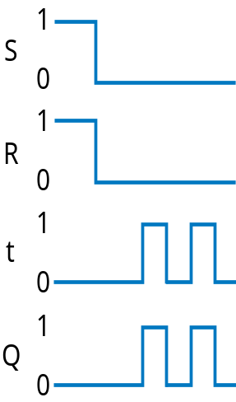
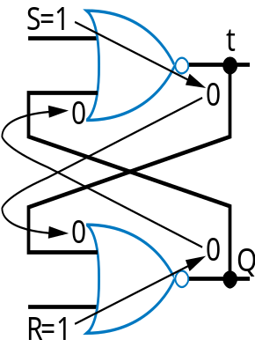
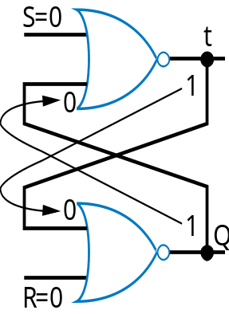
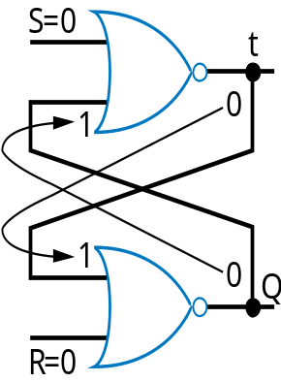

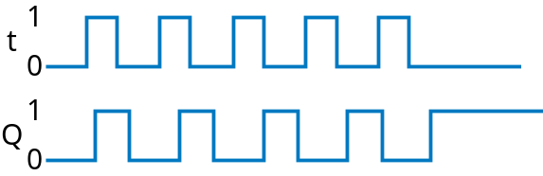
Problem with SR Latch
Problem
  If S=1 and R=1 simultaneously, we don’t know what value Q will take
Q may oscillate. Then, because one path will be slightly longer than the other, Q will eventually settle to 1 or 0 – but we don’t know which.

Slide 8
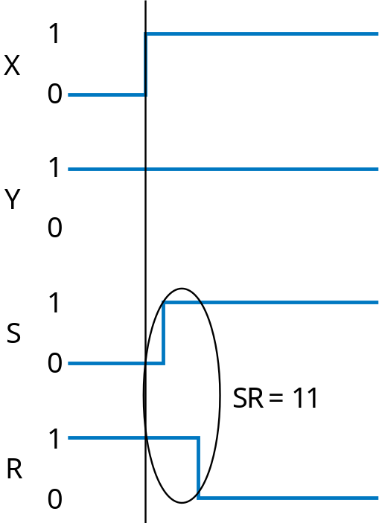
Problem with SR Latch
Problem not just one of a user pressing two buttons at same time
Can also occur even if SR inputs come from a circuit that supposedly never sets S=1 and R=1 at same time
  But does, due to different delays of different paths
A
r
bit
r
a
r
y
SR latch
X
circuit
S
Q
Y
R
The longer path from X to R than to S causes SR=11 for short time – could be long enough to cause oscillation

Slide 9
Solution: Level-Sensitive SR Latch
Add enable input “C” as shown
  Only let S and R change when C=0
    Enure circuit in front of SR never sets SR=11, except briefly due to path delays
  Change C to 1 only after sufficient time for S and R to be stable
  When C becomes 1, the stable S and R value passes through the two AND gates to the SR latch’s S1 R1 inputs.
Level-sensitive SR latch
S
S1
C
Q
R
R1
Though SR=11 briefly...
S
Q
’
Level-sensitive SR latch
1
C
Q
S
S
0
R
X
S1
R
1
Level-sensitive SR latch symbol
0
Clk
C
1
a
C
0
Q
S1
1
R
R1
0
Y
R1
1
0
...S1R1 never = 11

Slide 10
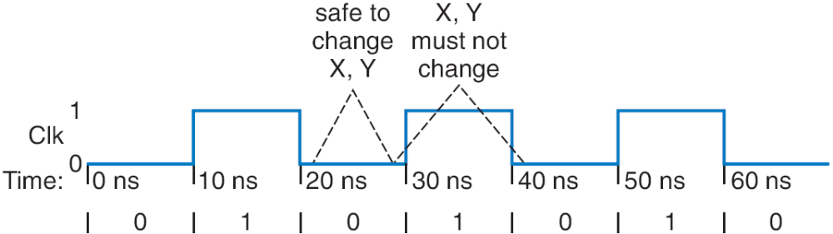
Clock Signals for a Latch
How do we know when it’s safe to set C=1?
  Most common solution –make C pulse up/down
    C=0: Safe to change X, Y
    C=1: Must not change X, Y
    We’ll see how to ensure that later
  Clock signal -- Pulsing signal used to enable latches
    Because it ticks like a clock
  Sequential circuit whose storage components all use clock signals: synchronous circuit
    Most common type
    Asynchronous circuits – important topic, but left for advanced course
Level-sensitive SR latch
X
S
S1
Clk
C
Q
R
R1
Y

Slide 11
Clocks
Clock period: time interval between pulses
  Above signal: period = 20 ns
Clock cycle: one such time interval
  Above signal shows 3.5 clock cycles
Clock frequency: 1/period
  Above signal: frequency = 1 / 20 ns = 50 MHz
    1 Hz = 1/s
Freq
Period
100 GHz
0.01 ns
10 GHz
0.1 ns
1 GHz
1 ns
100 MHz
10 ns
10 MHz
100 ns

Slide 12
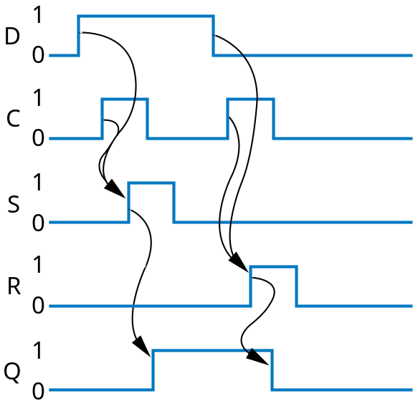
Level-Sensitive D Latch
SR latch requires careful design to ensure SR=11 never occurs
D latch relieves designer of that burden
  Inserted inverter ensures R always opposite of S
D latch
D
S
C
Q
R
D
Q
’
C
Q
D latch symbol

Slide 13
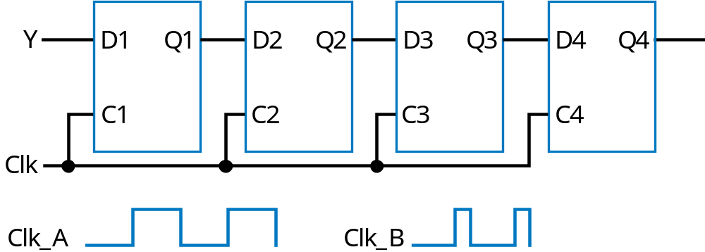
Problem with Level-Sensitive D Latch
D latch still has problem (as does SR latch)
  When C=1, through how many latches will a signal travel?
  Depends on for how long C=1
    Clk_A -- signal may travel through multiple latches
    Clk_B -- signal may travel through fewer latches
  Hard to pick C that is just the right length
    Can we design bit storage that only stores a value on the rising edge of a clock signal?
rising edges
Clk

Slide 14
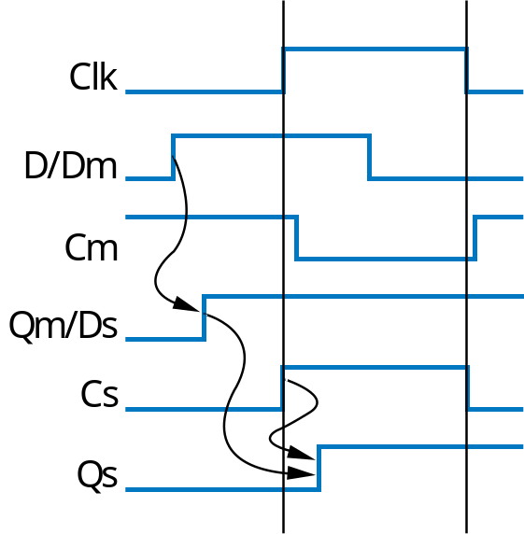
D Flip-Flop
Flip-flop: Bit storage that stores on clock edge, not level
One design -- master-servant
  Two latches, output of first goes to input of second, master latch has inverted clock signal
  So master loaded when C=0, then servant when C=1
  When C changes from 0 to 1, master disabled, servant loaded with value that was at D just before C changed -- i.e., value at D during rising edge of C
rising edges
Clk
Note: Hundreds of different flip-flop designs exist
D flip-flop
D latch
D latch
D
Q
’
Dm
Qm
Ds
Q
s
’
C
m
Cs
Qs
Q
master
servant
Clk

Slide 15
D Flip-Flop
D
Q
’
D
Q
’
Internal design: Just invert servant clock rather than master
The triangle means clock input, edge triggered
Q
Q
Symbol for rising-edge
triggered D flip-flop
Symbol for falling-edge
triggered D flip-flop
rising edges
falling edges
Clk
Clk

Slide 16
D Flip-Flop
Solves problem of not knowing through how many latches a signal travels when C=1
  In figure below, signal travels through exactly one flip-flop, for Clk_A or Clk_B
  Why? Because on rising edge of Clk, all four flip-flops are loaded simultaneously -- then all four no longer pay attention to their input, until the next rising edge. Doesn’t matter how long Clk is 1.
T
Y
D1
Q1
D2
Q2
D3
Q3
D4
Q4
inside each
fli
w
p
o l
Two latches inside each flip-flop
-flop
a
t
ches
Clk
Clk_A
Clk_B

Slide 17
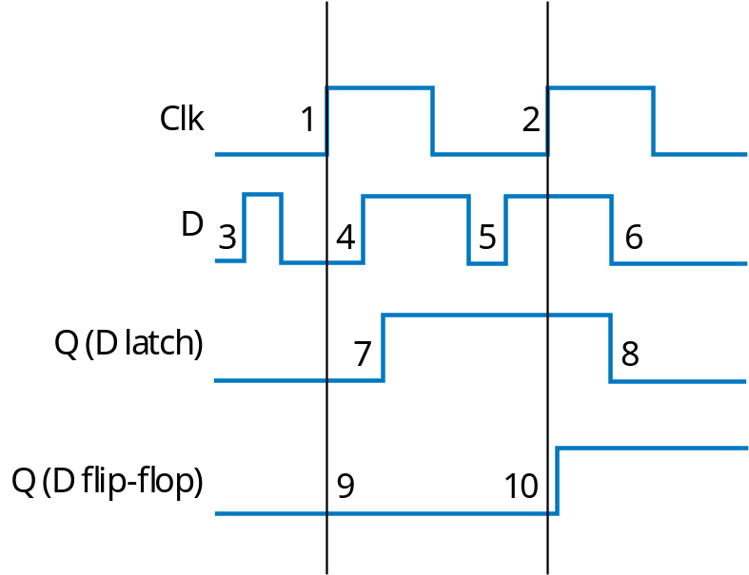
D Latch vs. D Flip-Flop
Latch is level-sensitive: Stores D when C=1
Flip-flop is edge triggered: Stores D when C changes from 0 to 1
  Saying “level-sensitive latch,” or “edge-triggered flip-flop,” is redundant
  Two types of flip-flops -- rising or falling edge triggered.
Comparing behavior of latch and flip-flop:

Slide 18
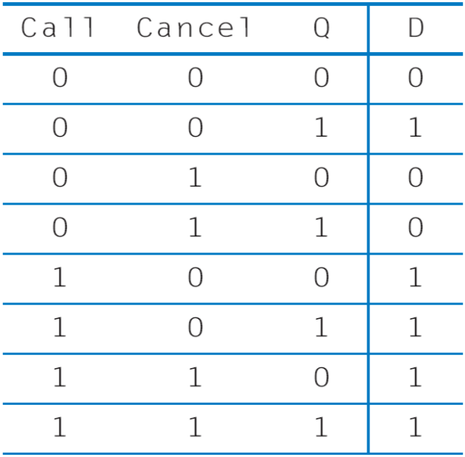
Flight-Attendant Call Button Using D Flip-Flop
D flip-flop will store bit
Inputs are Call, Cancel, and present value of D flip-flop, Q
Truth table shown below
C
all
Flight
attendant
call-button
system
Blue
light
but
t
on
C
an
c
el
but
t
on
Preserve value: if Q=0, make D=0; if Q=1, make D=1
Circuit derived from truth table, using Chapter 2 combinational logic design process
Cancel -- make D=0
C
all
Call
but
t
on
D
Q’
Blue
light
C
an
c
el
Cancel
Call -- make D=1
but
t
on
Q
Clk
Q
Let’s give priority to Call -- make D=1

Slide 19
Bit Storage Summary
SR latch
Level-sensitive SR latch
D latch
D flip-flop
S (set)
S
S1
D
S
D latch
D latch
D
Dm
Qm
Ds
Qs’
Q
’
C
C
Q
C
m
Cs
Qs
Q
R
Q
Q
master
servant
R (reset)
R1
R
Clk
Feature: S=1 sets Q to 1, R=1 resets Q to 0. Problem: SR=11 yield undefined Q.
Feature: S and R only have effect when C=1. We can design outside circuit so SR=11 never happens when C=1. Problem: avoiding SR=11 can be a burden.
Feature: SR can’t be 11 if D is stable before and while C=1, and will be 11 for only a brief glitch even if D changes while C=1. Problem: C=1 too long propagates new values through too many latches: too short may not enable a store.
Feature: Only loads D value present at rising clock edge, so values can’t propagate to other flip-flops during same clock cycle. Tradeoff: uses more gates internally than D latch, and requires more external gates than SR – but gate count is less of an issue today.
We considered increasingly better bit storage until we arrived at the robust D flip-flop bit storage

Slide 20
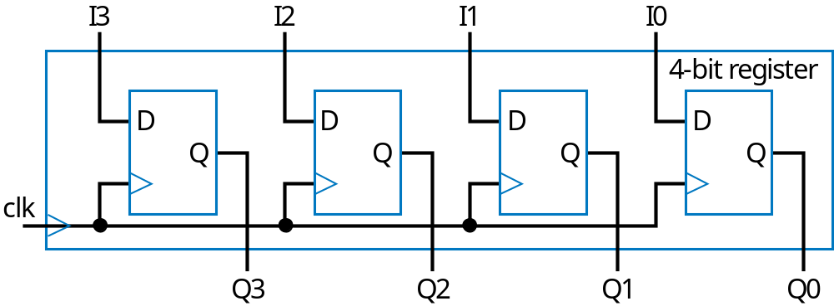
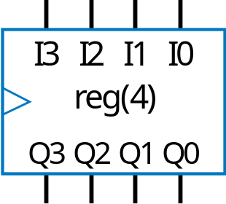
Basic Register
Typically, we store multi-bit items
  e.g., storing a 4-bit binary number
Register: multiple flip-flops sharing clock signal
  From this point, we’ll use registers for bit storage
    No need to think of latches or flip-flops
    But now you know what’s inside a register

Slide 21
Example Using Registers: Temperature Display
Temperature history display
  Sensor outputs temperature as 5-bit binary number
  Timer pulses C every hour
  Record temperature on each pulse, display last three recorded values
Present
1 hour ago
2 hours ago
Display
Display
Display
x4
a4
a3
a2
a1
a0
b4
b3
b2
b1
b0
c4
c3
c2
c1
c0
e
x3
r
tu
x2
a
r
TemperatureHistoryStorage
sensor
x1
empe
x0
t
timer
C
(In practice, we would actually avoid connecting the timer output
C to a clock input, instead only connecting an oscillator output to a clock input.)

Slide 22
Example Using Registers: Temperature Display
Use three 5-bit registers
a4
a3
a2
a1
a0
b4
b3
b2
b1
b0
c4
c3
c2
c1
c0
x4
I
4
Q4
I
4
Q4
I
4
Q4
x3
I
3
Q3
I
3
Q3
I
3
Q3
x2
I
2
Q2
I
2
Q2
I
2
Q2
x1
I
1
Q1
I
1
Q1
I
1
Q1
x0
I
0
Q0
I
0
Q0
I
0
Q0
C
R
a
R
b
R
c
TemperatureHistoryStorage
x4...x0
15
18
20
21
21
22
24
24
24
25
25
26
26
26
27
27
27
27
C
R
a
0
18
21
24
25
26
27
R
b
0
0
18
21
24
25
26
R
c
0
0
0
18
21
24
25

Slide 23
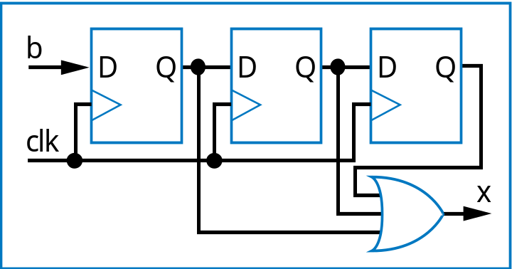
Finite-State Machines (FSMs) and Controllers
3.3
Want sequential circuit with particular behavior over time
Example: Laser timer
  Push button: x=1 for 3 clock cycles
  How? Let’s try three flip-flops
    b=1 gets stored in first D flip-flop
    Then 2nd flip-flop on next cycle, then 3rd flip-flop on next
    OR the three flip-flop outputs, so x should be 1 for three cycles
b
Controller
x
laser
clk
patient

Slide 24
Need a Better Way to Design Sequential Circuits
Trial and error is not a good design method
  Will we be able to “guess” a circuit that works for other desired behavior?
    How about counting up from 1 to 9? Pulsing an output for 1 cycle every 10 cycles? Detecting the sequence 1 3 5 in binary on a 3-bit input?
  And, a circuit built by guessing may have undesired behavior
    Laser timer: What if press button again while x=1? x then stays one another 3 cycles. Is that what we want?
Combinational circuit design process had two important things
  A formal way to describe desired circuit behavior
    Boolean equation, or truth table
  A well-defined process to convert that behavior to a circuit
We need those things for sequence circuit design

Slide 25
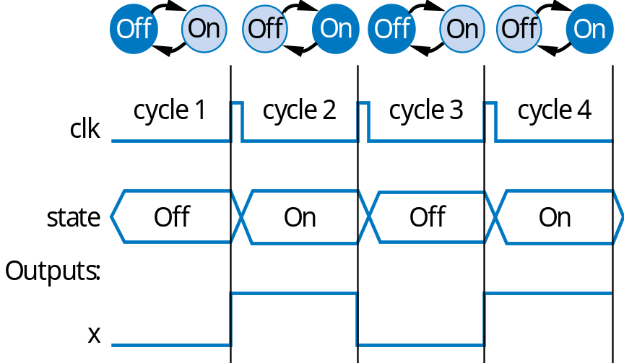
Describing Behavior of Sequential Circuit: FSM
Finite-State Machine (FSM)
  A way to describe desired behavior of sequential circuit
    Akin to Boolean equations for combinational behavior
  List states, and transitions among states
    Example: Make x change toggle (0 to 1, or 1 to 0) every clock cycle
    Two states: “Off” (x=0), and “On” (x=1)
    Transition from Off to On, or On to Off, on rising clock edge
    Arrow with no starting state points to initial state (when circuit first starts)
Outputs: x
x=0
clk
^
x=1
O
ff
On
clk
^

Slide 26
FSM Example: 0,1,1,1,repeat
Want 0, 1, 1, 1, 0, 1, 1, 1, ...
  Each value for one clock cycle
Can describe as FSM
  Four states
  Transition on rising clock edge to next state
Outputs: x
x=0
clk
^
x=1
clk
^
x=1
clk
^
x=1
O
ff
On1
On2
On3
clk
^
clk
State
O
ff
On1
On2
On3
O
ff
On1
On2
On3
O
ff
Outputs:
x

Slide 27
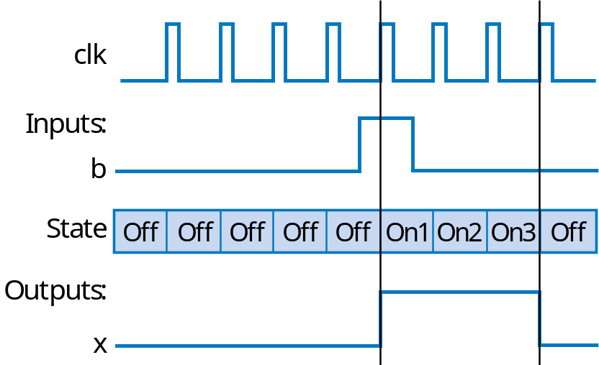
Extend FSM to Three-Cycles High Laser Timer
Four states
Wait in “Off” state while b is 0 (b’)
When b is 1 (and rising clock edge), transition to On1
  Sets x=1
  On next two clock edges, transition to On2, then On3, which also set x=1
So x=1 for three cycles after button pressed
Inputs: b; Outputs: x
x=0
clk
^
O
ff
b
’*clk
^
b*clk
^
x=1
clk
^
x=1
clk
^
x=1
On1
On2
On3

Slide 28
FSM Simplification: Rising Clock Edges Implicit
Showing rising clock on every transition: cluttered
  Make implicit -- assume every edge has rising clock, even if not shown
  What if we wanted a transition without a rising edge
    We don’t consider such asynchronous FSMs -- less common, and advanced topic
    Only consider synchronous FSMs -- rising edge on every transition
Inputs: b; Outputs: x
x=0
clk
^
O
ff
b’
*clk
^
b
*clk
^
x=1
clk
^
x=1
clk
^
x=1
On1
On2
On3
Inputs: b; Outputs: x
x=0
Off
b
’
a
b
x=1
x=1
x=1
On1
On2
On3
Note: Transition with no associated condition thus transistions to next state on next clock cycle

Slide 29
FSM Definition
FSM consists of
  Set of states
    Ex: {Off, On1, On2, On3}
  Set of inputs, set of outputs
    Ex: Inputs: {x}, Outputs: {b}
  Initial state
    Ex: “Off”
  Set of transitions
    Describes next states
    Ex: Has 5 transitions
  Set of actions
    Sets outputs while in states
    Ex: x=0, x=1, x=1, and x=1
Inputs: b; Outputs: x
x=0
Off
b
’
b
x=1
x=1
x=1
On1
On2
On3
We often draw FSM graphically, known as state diagram
Can also use table (state table), or textual languages

Slide 30

FSM Example: Secure Car Key
Many new car keys include tiny computer chip
  When car starts, car’s computer (under engine hood) requests identifier from key
  Key transmits identifier
    If not, computer shuts off car
FSM
  Wait until computer requests ID (a=1)
  Transmit ID (in this case, 1101)
Inputs: a; Outputs: r
Wait
r=0
a
a
’
K1
K2
K3
K4
r=1
r=1
r=0
r=1

Slide 31
FSM Example: Secure Car Key (cont.)
Nice feature of FSM
  Can evaluate output behavior for different input sequence
  Timing diagrams show states and output values for different input waveforms
I
nputs:
a
;
O
utputs:
r
W
ait
r=0
a
a
’
K1
K2
K3
K4
r=1
r=1
r=0
r=1
Q: Determine states and r value for given input waveform:
clk
clk
nputs
I
I
nputs
a
a
S
t
a
t
e
W
ait
W
ait
K1
K2
K3
K4
W
ait
W
ait
State
W
ait
W
ait
K1
K2
K3
K4
W
ait
K1
O
utputs
Output
a
r
r

Slide 32
FSM Example: Code Detector
Unlock door (u=1) only when buttons pressed in sequence:
  start, then red, blue, green, red
Input from each button: s, r, g, b
  Also, output a indicates that some colored button pressed
FSM
  Wait for start (s=1) in “Wait”
  Once started (“Start”)
    If see red, go to “Red1”
    Then, if see blue, go to “Blue”
    Then, if see green, go to “Green”
    Then, if see red, go to “Red2”
      In that state, open the door (u=1)
    Wrong button at any step, return to “Wait”, without opening door
Start
s
u
Red
r
Code
Door
a
Green
g
detector
lock
Blue
b
a
Inputs: s,r,g,b,a;
Outputs: u
Wait
u=0
s
s
’
a
r
’
a
b
’
a
g
’
a
r
’
a
Start
a
’
u=0
ar
ab
ag
ar
Red1
Blue
Green
R
ed2
a
’
a
’
a
u=0
’
u=0
u=0
u=1
Q: Can you trick this FSM to open the door, without knowing the code?
a
A: Yes, hold all buttons simultaneously

Slide 33
Improve FSM for Code Detector
Inputs: s,r,g,b,a;
Outputs: u
Wait
u=0
s’
ar’
ab’
ag’
ar’
s
a
Start
u=0
a
’
ar
ab
ag
ar
Red1
Blue
Green
Red2
a
’
a
’
a
’
u=0
u=0
u=0
u=1
Note: small problem still remains; we’ll discuss later
New transition conditions detect if wrong button pressed, returns to “Wait”
FSM provides formal, concrete means to accurately define desired behavior

Slide 34
Standard Controller Architecture
How implement FSM as sequential circuit?
  Use standard architecture
    State register -- to store the present state
    Combinational logic -- to compute outputs, and next state
    For laser timer FSM
      2-bit state register, can represent four states
      Input b, output x
  Known as controller
Inputs: b; Outputs: x
x=0
Off
b
’
b
x=1
x=1
x=1
On1
On2
On3
FSM
inputs
outputs
b
x
FSM
FSM
outputs
Combinational
logic
n1
FSM
inputs
I
O
FSM
outputs
n0
Combinational
logic
s1
s0
a
S
m
clk
State register
clk
m-bit
state register
m
N
General version

Slide 35
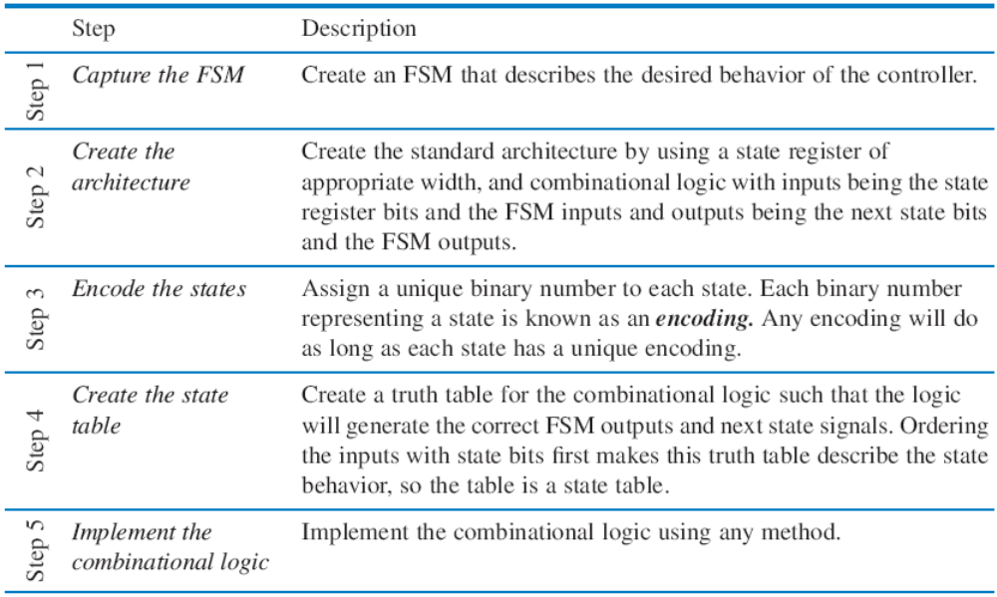
Controller Design
3.4
Five step controller design process

Slide 36
Controller Design: Laser Timer Example
Step 1: Capture the FSM
  Already done
Step 2: Create architecture
  2-bit state register (for 4 states)
  Input b, output x
  Next state signals n1, n0
Step 3: Encode the states
  Any encoding with each state unique will work
Inputs: b; Outputs: x
x=0
00
b
’
O
ff
a
b
x=1
x=1
x=1
01
On1
10
On2
11
On3
FSM
inputs
outputs
b
x
FSM
FSM
outputs
Combinational
logic
n1
n0
s1
s0
a
clk
State register

Slide 37
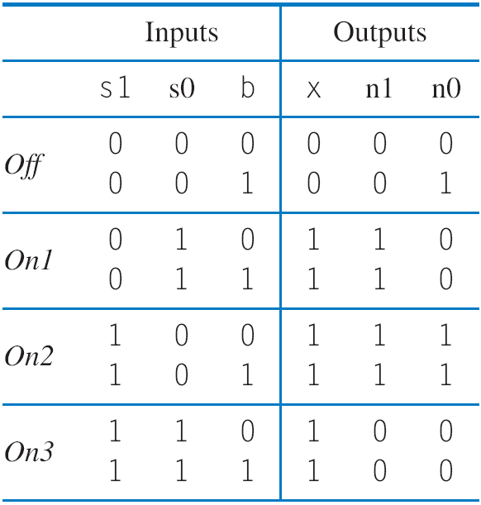
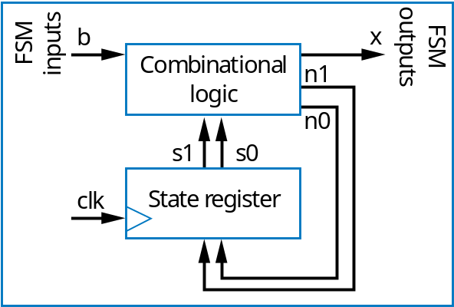
Controller Design: Laser Timer Example (cont)
Step 4: Create state table
Inputs: b; Outputs: x
x=0
00
b
’
O
ff
b
a
x=1
x=1
x=1
01
On1
10
On2
11
On3

Slide 38
Controller Design: Laser Timer Example (cont)
Step 5: Implement combinational logic
a
x = s1 + s0 (note from the table that x=1 if s1 = 1 or s0 = 1)
n1 = s1’s0b’ + s1’s0b + s1s0’b’ + s1s0’b
n1 = s1’s0 + s1s0’
n0 = s1’s0’b + s1s0’b’ + s1s0’b
n0 = s1’s0’b + s1s0’

Slide 39
Controller Design: Laser Timer Example (cont)
Step 5: Implement combinational logic (cont)
Combinational Logic
FSM outputs
b
x
FSM inputs
n1
a
n0
s1
s0
clk
State register
x = s1 + s0
n1 = s1’s0 + s1s0’
n0 = s1’s0’b + s1s0’

Slide 40
Understanding the Controller’s Behavior
x=0
x=0
x=0
00
b
’
00
b
’
00
b
’
O
ff
O
ff
O
ff
b
x=1
x=1
x=1
b
x=1
x=1
x=1
b
x=1
x=1
x=1
01
On1
10
On2
11
On3
01
On1
10
On2
11
On3
01
On1
10
On2
11
On3
b
0
x
b
0
x
b
0
x
0
0
0
1
0
0
1
1
1
0
0
1
n1
n1
n1
0
0
1
a
0
0
0
0
1
0
n0
n0
n0
0
1
0
0
0
0
clk
s1
s0
clk
s1
s0
clk
s1
s0
0
0
0
0
0
1
0
0
0
1
1
0
clk
st
a
t
e=00
st
a
t
e=00
st
a
t
e=01
I
nputs:
b
O
utputs:
x

Slide 41
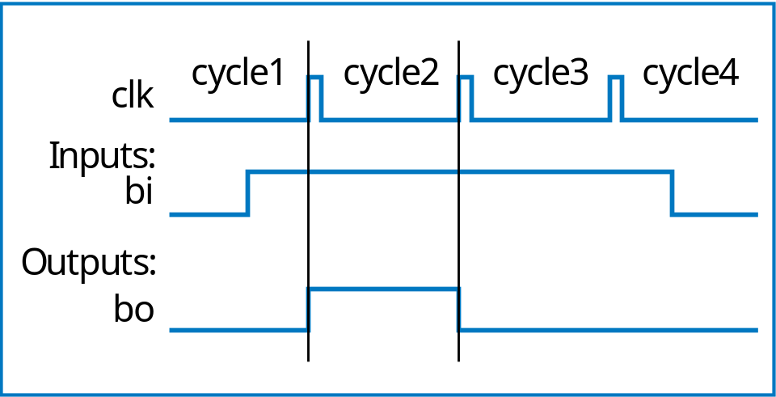
Controller Example:
Button Press Synchronizer
bi
Button press
synchronizer
controller
bo
Want simple sequential circuit that converts button press to single cycle duration, regardless of length of time that button actually pressed
  We assumed such an ideal button press signal in earlier example, like the button in the laser timer controller

Slide 42
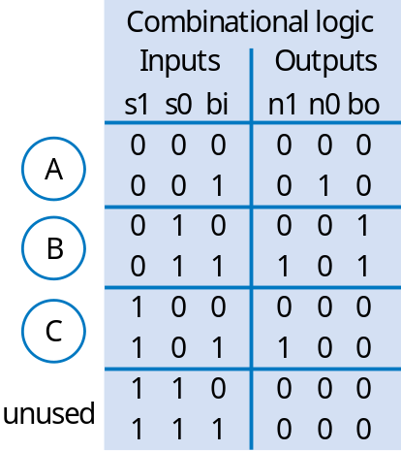
Controller Example:
Button Press Synchronizer (cont)
FSM inputs: bi; FSM outputs: bo
FSM
inputs
bi
bo
FSM
outputs
Step 2: Create architecture
Combinational
logic
bi
’
bi
n1
b
i
’
bi
’
n0
A
bi
B
bi
C
s1
s0
n1 = s1’s0bi + s1s0bi
n0 = s1’s0’bi
bo = s1’s0bi’ + s1’s0bi = s1s0
a
bo=0
bo=1
bo=0
clk
State register
Step 1: FSM
Combinational logic
outputs
bo
bi
FSM
n1
FSM inputs: bi; FSM outputs: bo
bi
’
bi
n0
bi
’
bi
’
00
bi
01
bi
10
s1
s0
bo=0
bo=1
bo=0
State register
Step 3: Encode states
clk
Step 4: State table
Step 5: Create combinational circuit
Step 5: Create combinational circuit

Slide 43
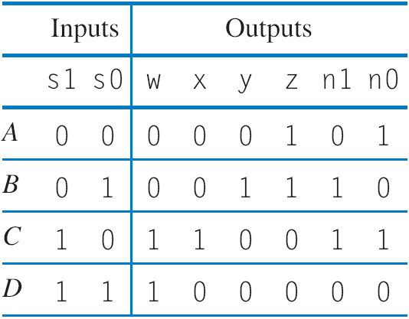
Controller Example: Sequence Generator
Want generate sequence 0001, 0011, 1100, 1000, (repeat)
  Each value for one clock cycle
  Common, e.g., to create pattern in 4 lights, or control magnets of a “stepper motor”
Inputs: none; Outputs: w,x,y,z
w
x
Inputs: none; Outputs: w,x,y,z
wxyz=0001
wxyz=1000
Combinational
logic
y
wxyz=0001
wxyz=1000
z
A
D
n1
A
00
D
11
n0
s1
s0
01
10
B
C
clk
State register
B
C
wxyz=0011
wxyz=1100
wxyz=0011
wxyz=1100
Step 1: Create FSM
Step 2: Create architecture
Step 3: Encode states
w
FSM outputs
w = s1
x = s1s0’
y = s1’s0
z = s1’
n1 = s1 xor s0
n0 = s0’
x
y
z
a
s1
s0
n0
n1
clk
State register
Step 4: Create state table
Step 5: Create combinational circuit

Slide 44
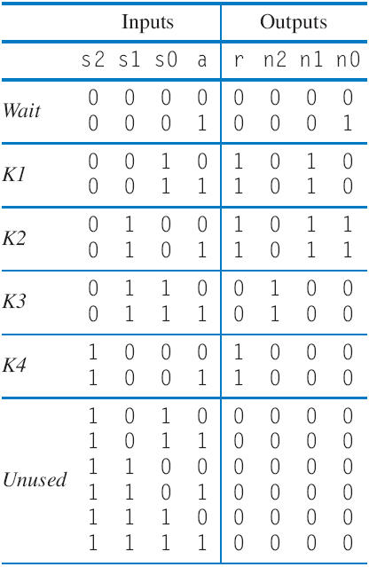
Controller Example: Secure Car Key
(from earlier example)
Inputs: a; Outputs: r
Wait
r=0
a
a
’
Step 1
K1
K2
K3
K4
a
r=1
r=1
r=0
r=1
a
outputs
r
Combinational
logic
FSM
FSM
n2
inputs
Step 2
n1
n0
s2
s1
s0
clk
State register
nputs:
I
a
;
O
utputs:
r
000
r=0
a
’
a
Step 3
001
010
011
100
r=1
r=1
r=0
r=1
We’ll omit Step 5
Step 4

Slide 45
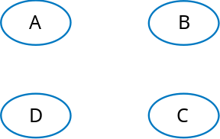
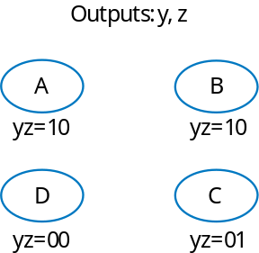
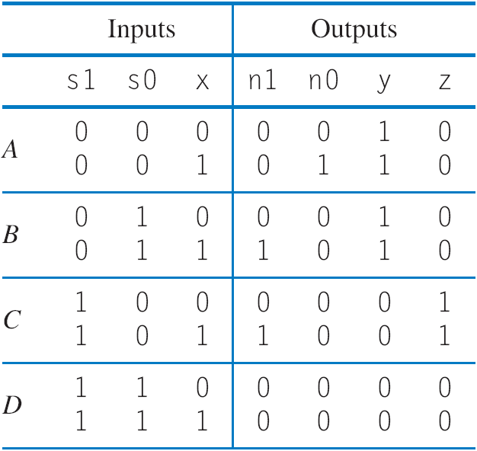
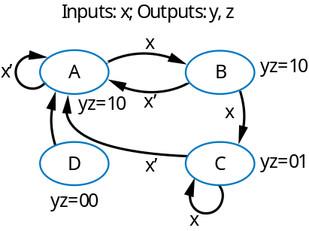
Example: Seq. Circuit to FSM (Reverse Engineering)
What does this
circuit do?
y=s1’
z = s1s0’
n1=(s1 xor s0)x
n0=(s1’*s0’)x
a
states
FSM outputs
x
y
z
FSM inputs
states with outputs
n1
n0
s1
s0
clk
State register
Work backwards
Pick any state names you want
states with outputs and transitions

Slide 46
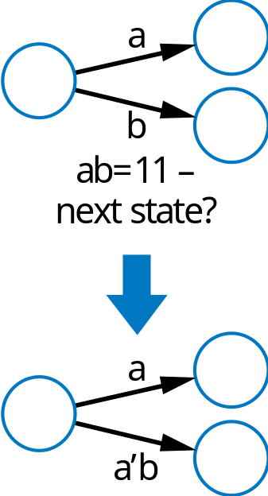
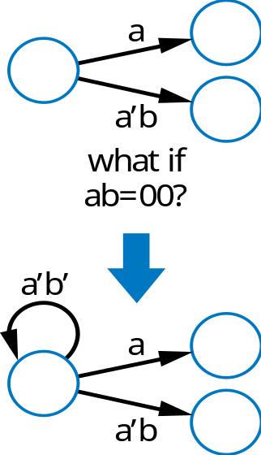
Common Pitfalls Regarding Transition Properties
Only one condition should be true
  For all transitions leaving a state
  Else, which one?
One condition must be true
  For all transitions leaving a state
  Else, where go?
a

Slide 47
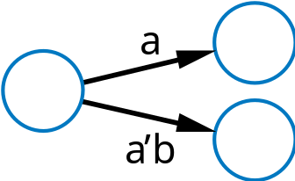
Verifying Correct Transition Properties
Can verify using Boolean algebra
  Only one condition true: AND of each condition pair (for transitions leaving a state) should equal 0 → proves pair can never simultaneously be true
  One condition true: OR of all conditions of transitions leaving a state) should equal 1 → proves at least one condition must be true
  Example
Answer:
a * a’b
= (a * a’) * b
= 0 * b
= 0
OK!
a
a + a’b
= a*(1+b) + a’b
= a + ab + a’b
= a + (a+a’)b
= a + b
Fails! Might not be 1 (i.e., a=0, b=0)
Q: For shown transitions, prove whether:
* Only one condition true (AND of each pair is always 0)
* One condition true (OR of all transitions is always 1)

Slide 48
Evidence that Pitfall is Common
Recall code detector FSM
  We “fixed” a problem with the transition conditions
  Do the transitions obey the two required transition properties?
    Consider transitions of state Start, and the “only one true” property
Wait
u=0
s
’
a
s
Start
u=0
a
’
ar
ab
ag
ar
Red1
Blue
Green
Red2
u=0
a
’
u=0
a
’
u=0
a
’
u=1
ar * a’ a’ * a(r’+b+g) ar * a(r’+b+g)
= (a*a’)r = 0*r = (a’*a)*(r’+b+g) = 0*(r’+b+g) = (a*a)*r*(r’+b+g) = a*r*(r’+b+g)
= 0 = 0 = arr’+arb+arg
= 0 + arb+arg
= arb + arg
= ar(b+g)
Intuitively: press red and blue buttons at same time: conditions ar, and a(r’+b+g) will both be true. Which one should be taken?
Q: How to solve?
a
A: ar should be arb’g’
(likewise for ab, ag, ar)
Fails! Means that two of Start’s transitions could be true
Note: As evidence the pitfall is common,
we admit the mistake was not intentional.
A reviewer of the book caught it.

Slide 49
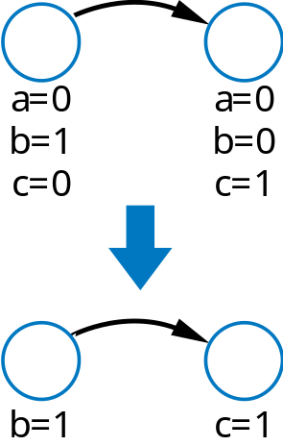
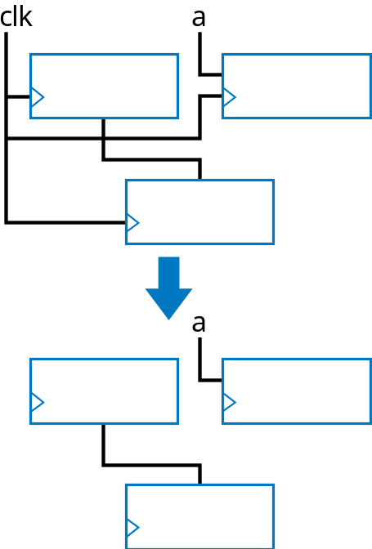
Simplifying Notations
FSMs
  Assume unassigned output implicitly assigned 0
Sequential circuits
  Assume unconnected clock inputs connected to same external clock
a

Slide 50
More on Flip-Flops and Controllers
3.5
Other flip-flop types
  SR flip-flop: like SR latch, but edge triggered
  JK flip-flop: like SR (S→J, R→K)
    But when JK=11, toggles
    1→0, 0→1
  T flip-flop: JK with inputs tied together
    Toggles on every rising clock edge
  Previously utilized to minimize logic outside flip-flop
    Today, minimizing logic to such extent is not as important
    D flip-flops are thus by far the most common

Slide 51
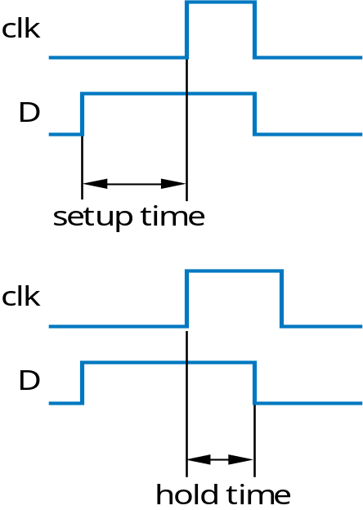
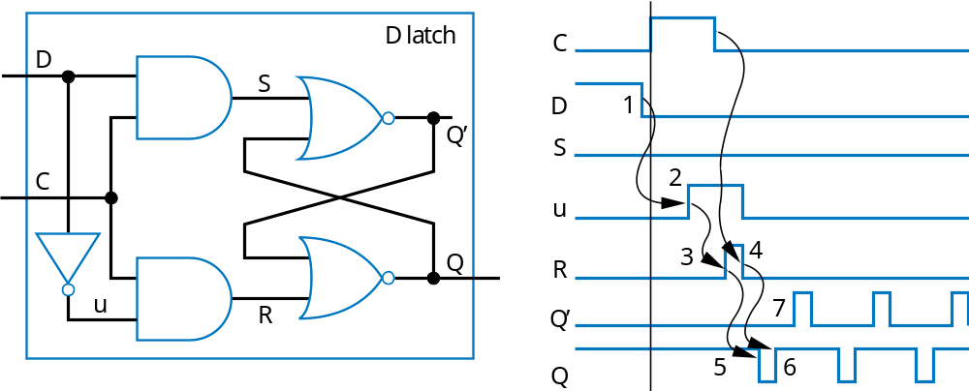
Non-Ideal Flip-Flop Behavior
Can’t change flip-flop input too close to clock edge
  Setup time: time that D must be stable before edge
    Else, stable value not present at internal latch
  Hold time: time that D must be held stable after edge
    Else, new value doesn’t have time to loop around and stabilize in internal latch
Setup time violation
Leads to oscillation!

Slide 52
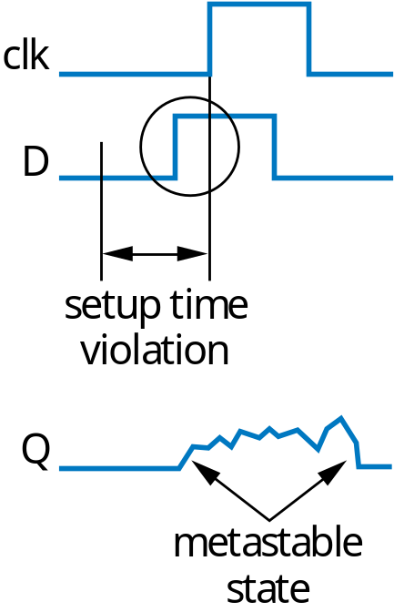
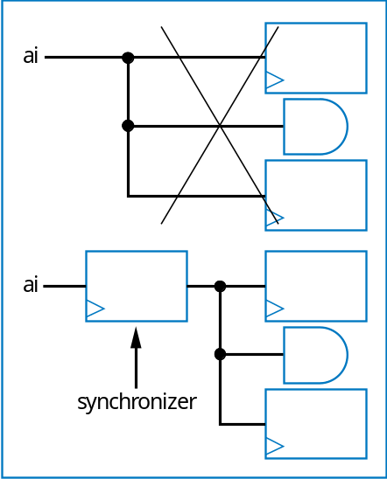
Metastability
Violating setup/hold time can lead to bad situation known as metastable state
  Metastable state: Any flip-flop state other than stable 1 or 0
    Eventually settles to one or other, but we don’t know which
  For internal circuits, we can make sure observe setup time
  But what if input comes from external (asynchronous) source, e.g., button press?
Partial solution
  Insert synchronizer flip-flop for asynchronous input
    Special flip-flop with very small setup/hold time
  Doesn’t completely prevent metastability
a

Slide 53
Metastability
One flip-flop doesn’t completely solve problem
How about adding more synchronizer flip-flops?
  Helps, but just decreases probability of metastability
So how solve completely?
  Can’t! May be unsettling to new designers. But we just can’t guarantee a design that won’t ever be metastable. We can just minimize the mean time between failure (MTBF) -- a number often given along with a circuit
Probability of flip-flop being metastable is…
very
very
very
incredibly
l
o
w
low
low
l
o
w
ai
synchronizers

Slide 54
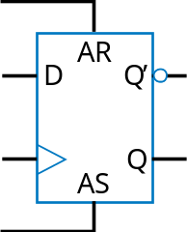
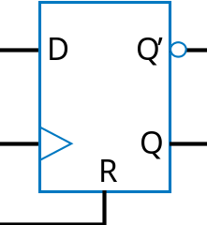
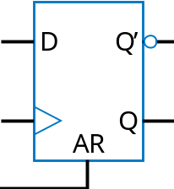
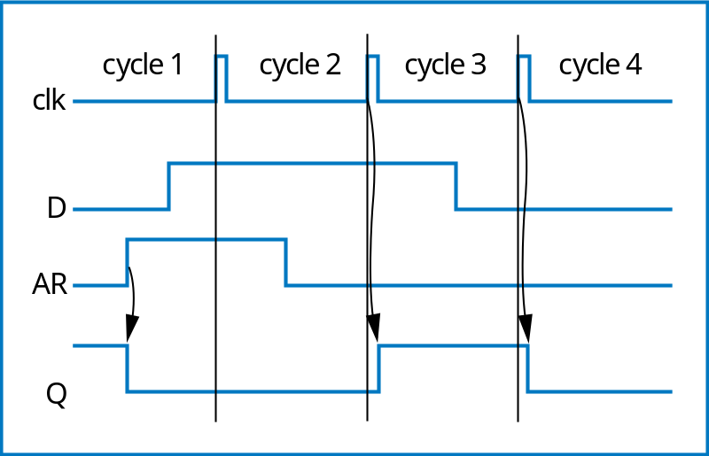
Flip-Flop Set and Reset Inputs
Some flip-flops have additional inputs
  Synchronous reset: clears Q to 0 on next clock edge
  Synchronous set: sets Q to 1 on next clock edge
  Asynchronous reset: clear Q to 0 immediately (not dependent on clock edge)
    Example timing diagram shown
  Asynchronous set: set Q to 1 immediately

Slide 55
Initial State of a Controller
All our FSMs had initial state
  But our sequential circuit designs did not
  Can accomplish using flip-flops with reset/set inputs
    Shown circuit initializes flip-flops to 01
  Designer must ensure reset input is 1 during power up of circuit
    By electronic circuit design
Inputs: x; Outputs: b
x=0
Off
b
’
b
x=1
x=1
x=1
On1
On2
On3
b
x
Combinational
logic
n1
n0
s1
s0
State register
clk
D
Q
’
D
Q
’
R
Q
S
Q
reset

Slide 56
Glitching
Glitch: Temporary values on outputs that appear soon after input changes, before stable new output values
Designer must determine whether glitching outputs may pose a problem
  If so, may consider adding flip-flops to outputs
    Delays output by one clock cycle, but may be OK

Slide 57
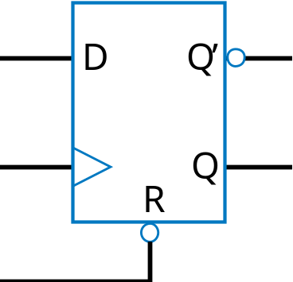
Active Low Inputs
We’ve assumed input action occur when input is 1
  Some inputs are instead active when input is 0 -- “active low”
  Shown with inversion bubble
  So to reset the shown flip-flop, set R=0. Else, keep R=1.

Slide 58
Chapter Summary
Sequential circuits
  Have state
Created robust bit-storage device: D flip-flop
  Put several together to build register, which we used to hold state
Defined FSM formal model to describe sequential behavior
  Using solid mathematical models -- Boolean equations for combinational circuit, and FSMs for sequential circuits -- is very important.
Defined 5-step process to convert FSM to sequential circuit
  Controller
So now we know how to build the class of sequential circuits known as controllers

